Slide 1
A funder repository of heterogeneous grey literature material with advanced user interface and presentation features
Ioanna-Ourania Stathopoulou, Nikos Houssos, Panagiotis Stathopoulos, Despina Hardouveli, Alexandra Roubani, Ioanna Sarantopoulou, Alexandros Soumplis, Chrysostomos Nanakos;
National Documentation Centre / National Hellenic Research Foundation, Greece

Slide 2
Agenda
Aims and scope of the project
Methodology and approach
Implementation
Conclusions – future work

Slide 3
The National Documentation Centre (EKT)
The national organisation in Greece:
for scientific documentation, online information and support services on research, science and technology
Objective: making knowledge accessible to everyone
Incorporated in National Hellenic Research Foundation (NHRF)
Implements the “National Information System for Research and Technology”: http://epset.gr
CRIS systems, Digital Repositories, e-Publishing, Digital Libraries, Interactive Culture, and more…
Open Access advocate: http://openaccess.gr, OPENAIRE,OPENAIRE+ member and NOAD.
Greek PhD theses archive: http://phdtheses.ekt.gr

Slide 4
Project context
Hellenic Ministry of Education programmes for education and lifelong learning, co-funded by the EU structural funds
Three phases: 1994-1999, 2000-2006, 2007-2013
Overall funds in the range of billion Euros
Activities funded:
Research: theses, collaborative projects
Studies, surveys, reports, project public deliverables
Conferences, workshops
Face-to-face courses / seminars
Creation of educational material
Most of them fall into the realm of “grey literature”

Slide 5
Aims and scope of the project
Decision by funding authority to create a repository (autumn 2010)
Aims: Dissemination, reuse and preservation of the digital material produced in the frame of the funded programmes
Single point of (persistent) access to material
Standards-based documentation/metadata, interoperability
Link of content to project / funding programme (by an external CRIS system)
Repository available (since spring 2011)
http://repository.edulll.gr

Slide 6
Motivation
For the general public:
Dissemination of the material to interested users
Reuse material for education, innovation, etc.
For government organisations:
Increased transparency regarding where public funding goes - reporting on contracts awards for studies to specific individuals and organisations
Avoid allocation of funding for work already done in the past

Slide 7
Project inputs and outputs
Input material:
Digital files arranged in folders – (hopefully) according to project
List of projects
No metadata!
Output aimed for:
Repository with standards compliant metadata records along with processed digital files, suitable for dissemination
Internal lightweight CRIS system combining digital items with project information and metadata
User-friendly interface for human users
Programmatic interface (OAI-PMH) for reuse by third-party software applications

Slide 8
Methodology and approach
Investigate input material
Identify content of archival value – exclude all other material (e.g. administrative documents)
Assign priorities to content
Documentation / cataloguing of material according to standards – application profile created
Subject cataloguing
No self-archiving at this phase
Digital processing of input files to produce copies suitable for preservation and dissemination – both initial and processed files kept in repository
A lot of effort allocated to user-friendly interfaces for browsing metadata and accessing content

Slide 9
Metadata schema
Custom application profile developed based on common international schemata
Qualified Dublin Core
LOM
PREMIS
CERIF
Vocabularies used
Eurovoc for thematic indexing – due to inter-disciplinarity and multi-linguality
Eurydice vocabulary for education levels

Slide 10
CERIF/CRIS functionality
A separate CERIF/CRIS has been developed running as a separate system than the repository
Represents in CERIF project, funding, organisation metadata and links with output
Structured representation, clear semantics using the CERIF Semantic Layer
Currently used as a private system – no public access

Slide 11
Linking CRIS and Repository
Complex links / roles
Reporting
Evaluation
Example links / roles
Organisation - Project:
Funder / Supervisor / Contractor
Person - Project:
Coordinator
Team leader
Team member
Evaluation
Current status:
Lightweight CERIF based CRIS for internal use
CRIS
Funder Repository
Persistent ids to docs
Content presentation
Rights
Access statistics

Slide 12
Repository Digital items workflow
Create metadata record.
Upload initial digital files to repository.
Handle assigned to record.
Metadata record published. Digital files not visible.
Digital file processing
instructions
Digital file processing
(format transformations, merging/splitting, OCR, file rename)
Publication of processed digital files

Slide 13
Repository s/w extensions
DSpace based with extensions:
Submission form enhancements
User-friendly browsing (tagcloud, image-based type browsing)
Embedding of video files
Online reading / streaming of text material
To be included in Dspace 3.0
DSpace Testathon 3.0 (round 2)
https://jira.duraspace.org/browse/DS-1225
https://jira.duraspace.org/browse/DS-1231
https://jira.duraspace.org/browse/DS-1227

Slide 14
Submission form enhancements
Simplify procedure, fewer steps
Enter metadata and upload multiple files from single form
Subsequently edit metadata from submission form
Multi-lingual controlled vocabularies with user-friendly values
Various new widgets (e.g. language selection for fields, name processing)

Slide 15
User-friendly browsing
Tag cloud for subjects
Configurable from dspace.dfg – can be used for any other field indexed for browsing
Image-based browsing for content types

Slide 16
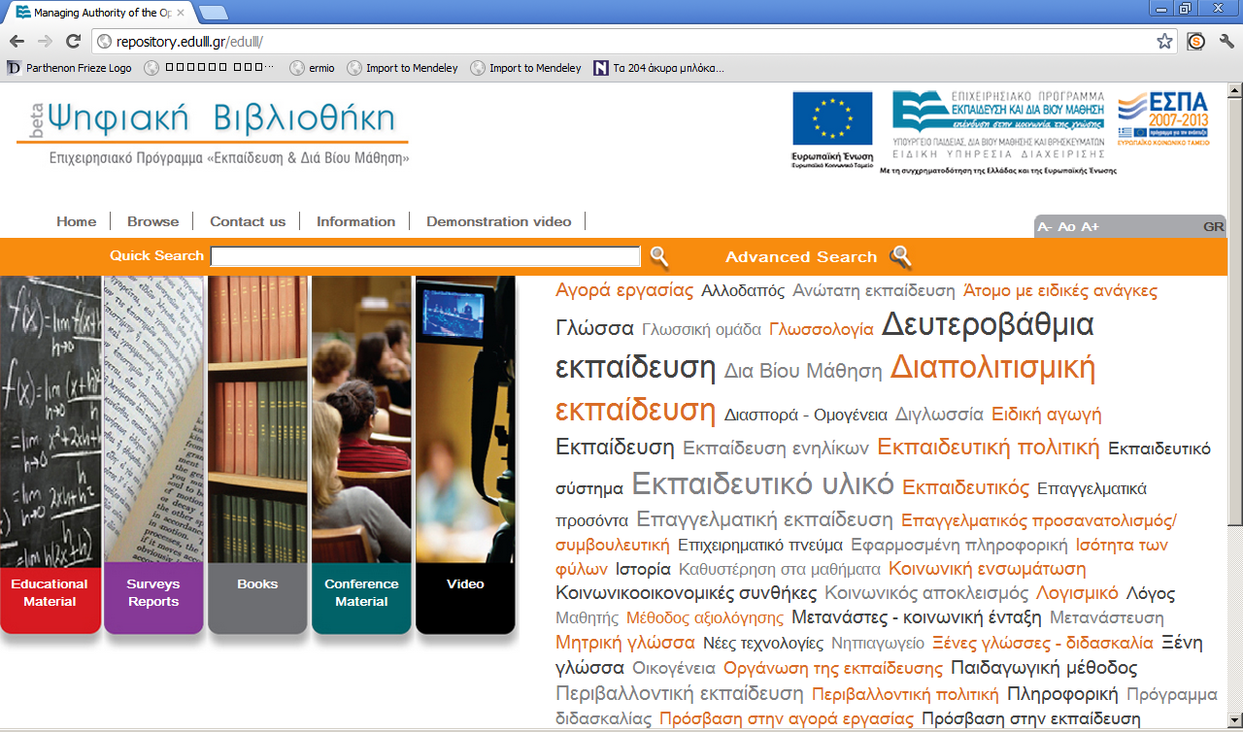

Slide 18
Embedding video files
H.264 enconding using a F4V video file container
Video stream provided by Woowza
Flowplayer selected from embedding video on metadata record page on repository
Video-related fields included to the metadata submission/edit form

Slide 19
Online reader for text
No need to download big files
Bookmarking/sharing at the page level
User access statistics at the page level
Compatible with multitouch interfaces / tablets
Based on the Internet Archive Book Reader
Pages are JPEG2000 files served by an image server
Sophisticated infrastructure for back-end processing

Slide 20
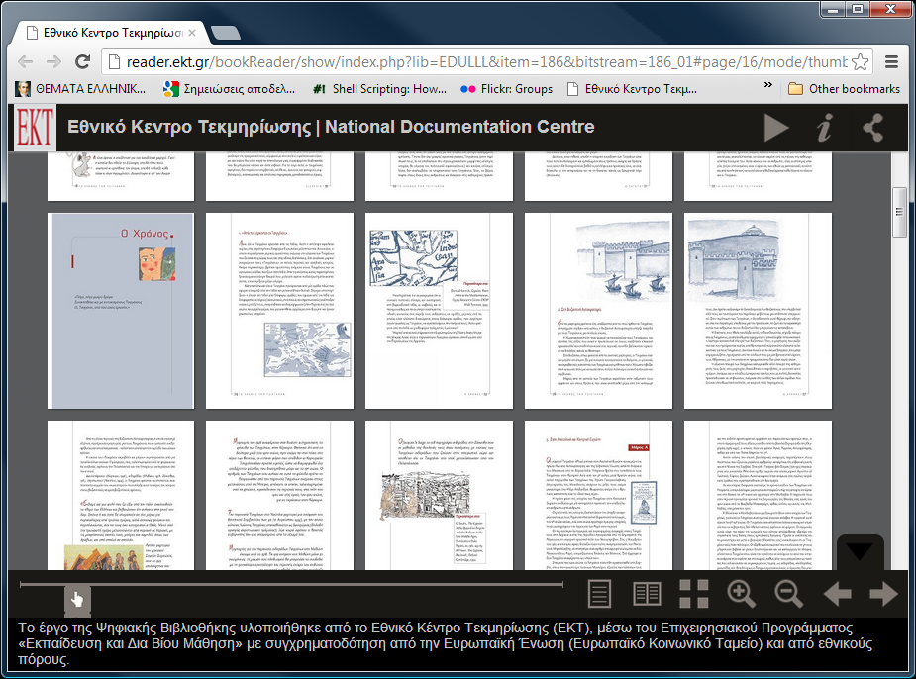
Online reader (screenshot)

Slide 21
Online reader backend
Two-tier backend:
content delivery and
content transformation
Content delivery:
Nginx/Varnish load balancer/caching to 2 node tomcat/djatoka cluster serving JPEG2000 over a shared SAN storage and utilising a 3 node Postgres 9 cluster
Content transformation
“Shadow” backend with specialized multithreaded content types transformation server
After transformation content copied to the delivery backend
Interfaced to OJS/Dspace
Manages the automatic batch conversion of content
Available as OSS (jp2k-distiller) http://code.google.com/p/jp2k-distiller/

Slide 22
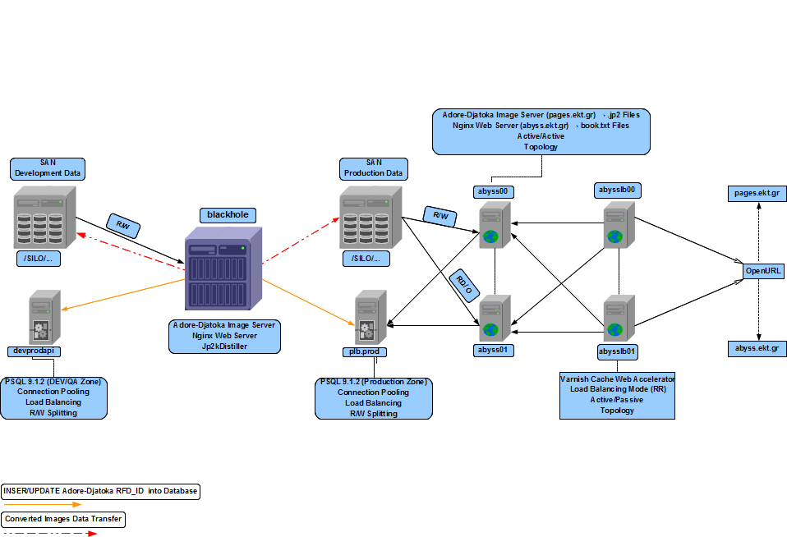

Slide 23
Future work
Support self-archiving (two phase cataloguing)
Integrate CERIF/CRIS functionality to the publicly available main system
Various new features for presentation of content

Slide 24
Thank you for your attention!
More info:
pstath@ekt.gr
nhoussos@ekt.gr
iostath@ekt.gr

